Slide 1
Computer Programming
JavaScript

Slide 2

Myth
Truth
A computer is an programmable electronic device that is used to do office work, and play games. It was recently invented.
The word computer was first introduced in the English language in 1640-50. It was introduced from French computeur. It originates from the Latin word computare, which is a verb that means to calculate or estimate.
So computers were known even when Jesus walked the Earth.

Slide 3
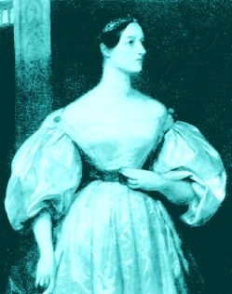
Myth
Truth
Computer programming is not for girls.
One of the first female programmers was Ada Lovelace. She lived 1815-1852.
She was an analyst, metaphysician, and known as the founder of scientific computing.

Slide 4

Myth
Truth
Computer programming is boring.
Computer programming is fun! It is like fitness for the brain.

Slide 5
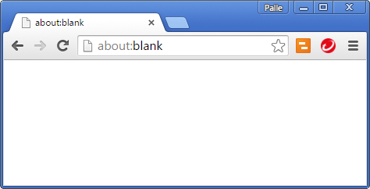
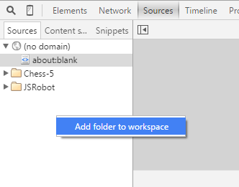
Chrome – Add Folder
F12

Slide 6
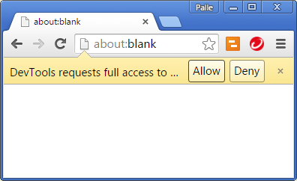
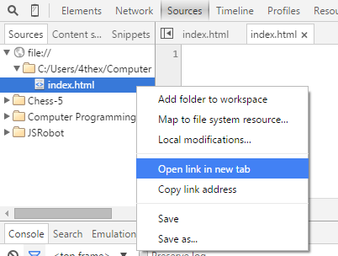
Chrome – Add Folder
Notes:
Add a file named ‘index.html’ in the folder, and it will appear in the ‘Sources’ area.

Slide 7
Web Page – index.html
<html>
<head>
<title>Name of my page</title>
<link rel="stylesheet" type="text/css" href="style.css"/>
<script type="text/javascript" src="main.js"></script>
</head>
<body>
</body>
</html>
Tag name, content, attribute name, attribute value

Slide 8
JavaScript Variables
var name = "Palle";
var age;
age = 47;
var danish = true;
var address = [55396, "Big River Dr.", "Bend", "OR", 97707];
or
var address = {
house: 55396, street: "Big River Dr.", city: "Bend",
state: "OR", zipcode: "97707"
};
var house = address.house;
String, Number, Boolean, Array, Object

Slide 9
+ operator
var sum = 1 + 2 + 3;
sum;
6
"The sum is " + sum;
The sum is 6

Slide 10
Functions
var add = function(a, b) {
return a+b;
};
var sum = add(5, 10);
sum;
15

Slide 11
Methods
var summer = {
add: function(a, b) {
return a+b;
}
};
summer.add(5, 10);
15

Slide 12
Function as argument
var executor = function(action, a, b) {
return action(a, b);
};
var add = function(a, b) {
return a+b;
};
executor(add, 5, 10);
15

Slide 13
Function as result
var summer = function(a) {
var b = 0;
var add = function() {
b += a;
return b;
};
return add;
};
var fiver = summer(5);
fiver();
5
fiver();
10

Slide 14
Condition
var sum = 1 + 2 + 3;
if(sum > 5) {
sum = 2;
}
sum;
2

Slide 15
Truthry conditions
5 == "5"
0 == false
1 == true
"true" != true
"0" == false
"1" == true
"word"
5

Slide 16
Truly true
5 === 5
"5" !== 5
true
!false
"word" === "word"
5 > 4
typeof("word") === "string"

Slide 17

String
"word".length;
4
"word".indexOf("or");
1
"word".slice(1, 3);
or
"1,2,3,4".split(",");
["1", "2", "3", "4"]

Slide 18

Number
5.toString();
"5"
5.2534.toFixed(2);
"5.25"
parseFloat("5.25");
5.25

Slide 19

Boolean
true.toString();
"true"
false.toString();
"false"
var falseString = "false";
var falseValue = (falseString === "true");
falseValue;
False

Slide 20
Array
var it = [1, 2, 3];
it.length;
3
it.pop();
3
[1, 2]
it.push(4);
[1, 2, 4]
it.shift();
1
[2, 4]
it.unshift(3);
[3, 2, 4]

Slide 21
Object

Slide 22
Statements
if…else
switch
for
for…in
while
do…while
try…catch…finally
throw

Slide 23
if...else
var count = 1;
if(count>5) {
count = 0;
} else {
count ++;
}
2

Slide 24
switch
var range;
var time;
switch(time) {
case "AM":
range = [0, 11];
break;
case "PM":
range = [12, 23];
break;
default:
// Not a valid time
}

Slide 25
for
var i;
var result = [];
for(i=1; i<5; i++) {
result.push(i);
}
result;
[1, 2, 3, 4]

Slide 26
for…in
var person = {first: "Palle", last: "Cogburn"};
var prop;
for(prop in person) {
console.log("person." + prop +
" = " + person[prop]);
}
person.first = Palle
person.second = Cogburn

Slide 27
while
var i = 1;
var result = [];
while(i < 5) {
result.push(i);
i++;
}
result;
[1, 2, 3, 4]

Slide 28
do…while
var i = 1;
var result = [];
do {
result.push(i);
i++;
} while(i < 5);
result;
[1, 2, 3, 4]

Slide 29
try…catch…finally
var value = "5";
try {
var number = value.toNumber();
} catch (error) {
console.log(error);
number = 0;
} finally {
// We will always do this
}
TypeError: value.toNumber is not a function(…)
number;
0

Slide 30
throw
var check = function(value) {
if(typeof(value) !== "string") {
throw "Argument value is not a string";
}
};
check(5);
Uncaught Argument value is not a string

Slide 31
Load event
window.addEventListener("load", function() {
// your code here
});

Slide 32
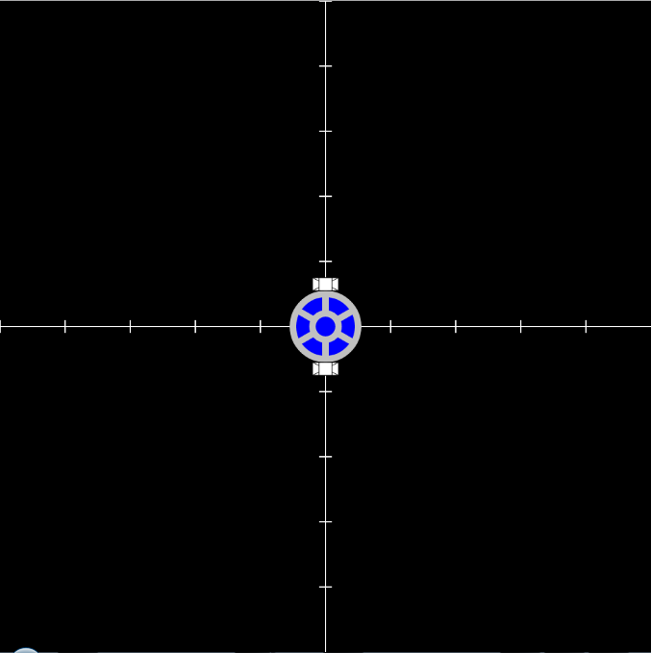
JSRobot
var field = Field();
var robot = JSRobot();
field.add(robot);

Slide 33
Set speeds
robot.setSpeeds(right, left);
Make the robot:
Move forward
Move backwards
Spin clockwise
Make a circle

Slide 34
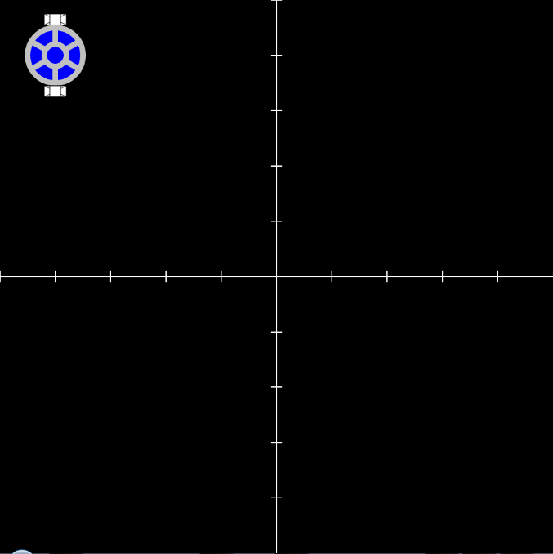
Set start
var robot = JSRobot({x: horizontal, y: vertical});
Make the robot start:
In the middle
In the top left corner
In the bottom left corner
In the bottom right corner

Slide 35
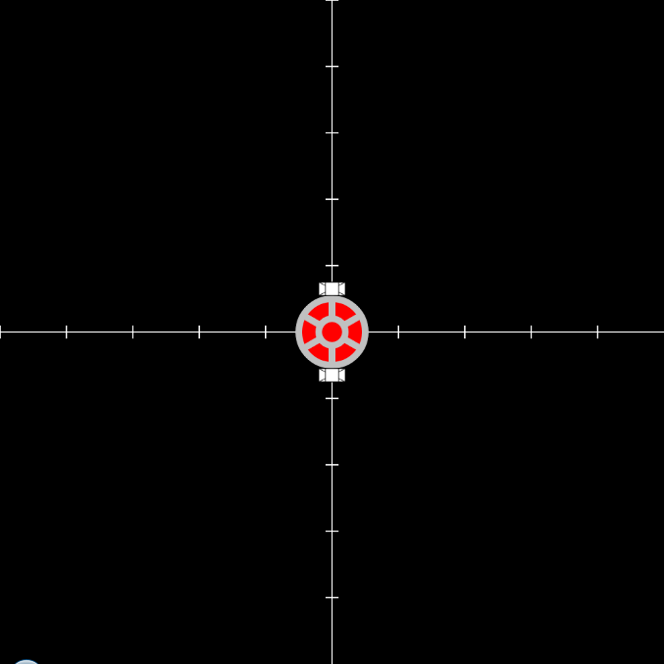
Set color
var robot = JSRobot({x: horizontal, y: vertical}, color);
The color argument is a string.
Make the robot:
Red
Yellow
Blue

Slide 36
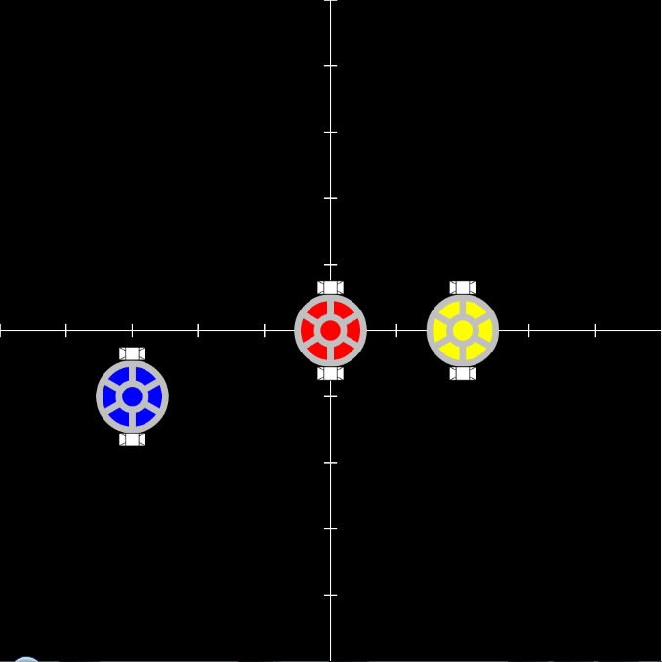
Make multiple robots
field.add(robot);

Slide 37
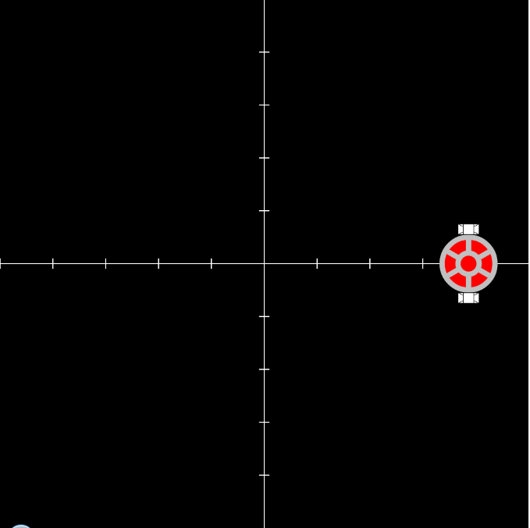
Make it stop
window.setTimeout(function() {
robot.stop();
}, 4000);

Slide 38
Listen to it
robot.onMove(function(location) {
// your code here
});
The location argument is an object:
{
previous: { x, y, direction},
current: { x, y, direction}
}

Slide 39
Control it
Use the onMove method to make the robot stop when it reaches y > 400.
Use a condition, and the if-statement.
if(y > 400) {
robot.stop();
}

